Slide 1
Monthly Expense and Budget Analyzer
Student Name K . Saanvi Roll No 2620090044
Student Name A . Kusuma Sree Roll No 2620030511

Slide 2
Abstract
The Monthly Expense and Budget Analyzer is a project developed to help users manage their monthly income, expenses, and budget in a simple and organized way. Nowadays, managing personal money can be difficult for many people. Expenses are often recorded in notebooks, paper receipts, or unorganized spreadsheets. These methods take time and can lead to calculation errors. People may also find it difficult to understand where their money is being spent and how much money is left at the end of the month. To solve these problems, a simple digital system is needed to keep all income and expense details in one place. The proposed system allows users to enter their monthly income, set a budget, and record their daily expenses. Expenses can be divided into different categories such as food, transportation, education, shopping, and entertainment. The system automatically calculates the total amount spent and the remaining budget, making it easier for users to keep track of their money. The system can also organize expenses into Needs, Wants, and Savings. This helps users understand their spending habits and identify unnecessary expenses. It can also help them plan their spending and savings more effectively . The main purpose of this project is to reduce manual calculations, save time, and provide a clear view of monthly spending. In the future, the system can be improved by adding monthly reports, savings tracking, budget alerts, and expense charts. Overall, the Monthly Expense and Budget Analyzer provides a simple and useful solution for tracking expenses and managing a monthly budget effectively.

Slide 3
Understanding Problem Statement
Managing monthly income and expenses manually can be difficult and time-consuming. People may record their expenses in notebooks, receipts, or unorganized spreadsheets, which can lead to calculation errors and make it difficult to understand their spending habits. There is also a lack of clear information about how much money has been spent, how much budget is remaining, and where most of the money is being used. Therefore, there is a need for a simple and organized Monthly Expense and Budget Analyzer that allows users to record their income, set a monthly budget, categorize expenses, automatically calculate total spending and remaining budget, and organize spending into Needs, Wants, and Savings. This system will help users reduce manual calculations, monitor their expenses, and manage their monthly budget more effectively .

Slide 4
CO 1 Topics
Variables & Data Types – store income, budget, expenses, etc.
Scanner / Input & Output – take user details.
Arithmetic Operators – calculate total expenses, balance, savings.
Relational Operators – compare expenses with the budget.
Logical Operators – combine multiple conditions.
Increment/Decrement Operators – maintain expense counters.
Ternary Operator – for simple conditions such as checking whether the budget is exceeded.
Type Casting – useful for percentage/average calculations.

Slide 5
Co 2 TOPICS
Conditional Statements – if, if-else, else-if for budget checking and categorization.
Loops – repeatedly enter multiple expenses.
break Statement – exit a menu or loop when required.
continue Statement – skip an invalid expense entry.

Slide 6
CO 3 Topics
Arrays – store multiple expense amounts/categories.
Methods – separate functions for calculating totals, balance, and displaying results.

Slide 7
CO 4 TOPICS
□ Classes & Objects – create expense records.
□ Constructors – initialize expense details.
□ Encapsulation – protect data using private variables.
□ Inheritance – reuse code from another class.
□ Method Overriding – redefine a method in a subclass.
□ Exception Handling – handle errors using try-catch.

Slide 8
CO 5 TOPICS
□ Strings – store expense categories and status.
□ StringBuilder – create the expense report.
□ Searching – find expenses by category.
□ Sorting – arrange expenses by amount.
□ File Handling – save and read the expense report.
□ Exception Handling – handle file errors

Slide 9
CO 6 TOPICS
□ ArrayList – store multiple expenses.
□ Lambda Expressions – sort expenses by amount.
□ Stream API – process expense records.
□ Calculating Total – find total expenses using sum().
□ Filtering – find expenses of ₹1,000 or more.
□ forEach() – display expense details.

Slide 10
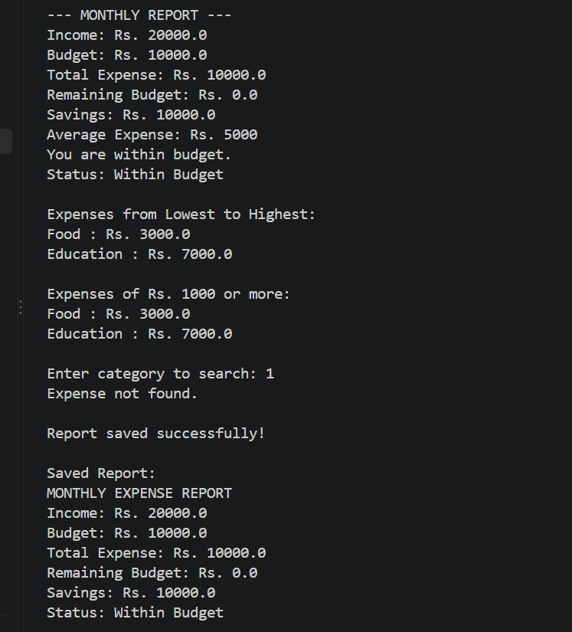
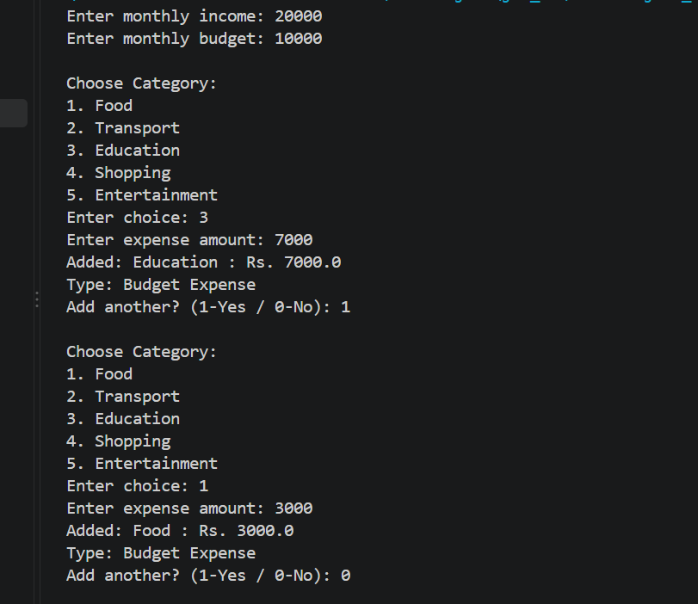
SCREENSHOTS

Slide 11
CONCLUSION
The Monthly Expense and Budget Analyzer is a simple and effective system designed to help users manage their monthly income, expenses, and savings.
It helps users record and categorize their daily expenses.
It automatically calculates total expenses and the remaining budget.
It reduces manual calculations, saves time, and minimizes errors.
It helps users understand their spending habits by organizing expenses into Needs, Wants, and Savings.
It demonstrates the practical application of Java programming concepts such as variables, operators, loops, arrays, methods, and classes.
Overall, this project encourages better financial planning, organized expense tracking, and smarter money management.

Slide 12
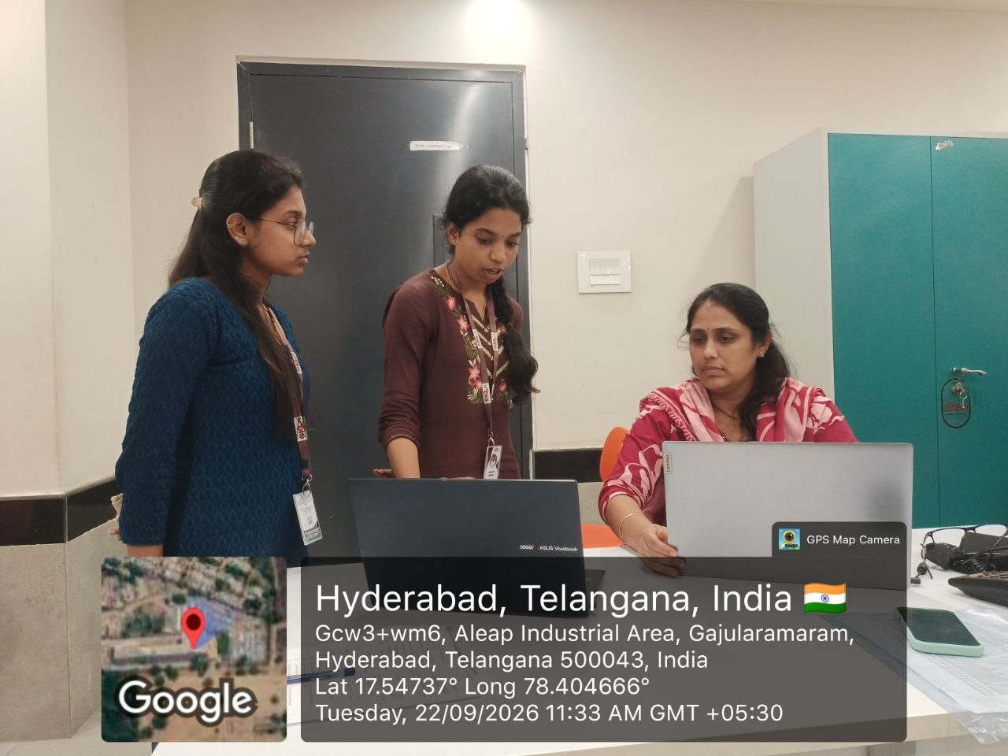
Geo Tag Photo and git hub link
https://github.com/saanvikanuganti
https://github.com/ambatikusumasree

